Slide 1

3D vision course
ETH Zürich
Explore Various Encodings for Implicit Scene Reconstruction
Stefan Lionar, Dusan Svilarkovic, Daniil Emtsev
Supervisor: Songyou Peng
27 May 2020, Zürich

Slide 2
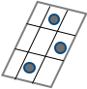
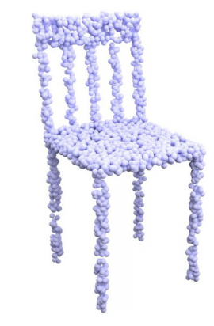
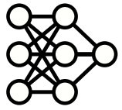
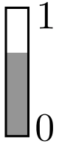

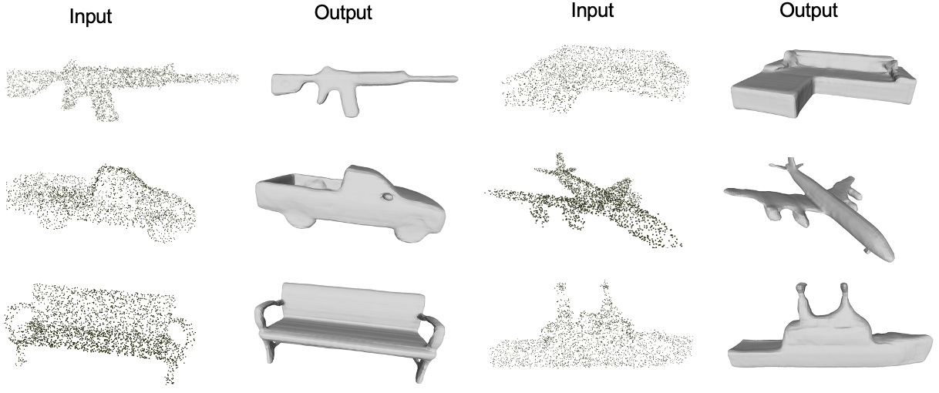
Dynamic Planar Convolutional Occupancy Networks (DPCO)
Input point clouds
N x 3
Projections to planes
3d point location
Features N x d
Sampling
Occupancy
probability
Unet
Features
Pointnet
H
W
Plane Predictor
Bilinear Interpolation
Simple PointNet + FCN
Sample output from our implementation
Previous work:
Convolutional occupancy networks (Peng, et al, 2020)*
Projection into static canonical planes
*Peng, S., Niemeyer, M., Mescheder, L., Pollefeys, M., & Geiger, A. (2020). Convolutional occupancy networks. arXiv preprint arXiv:2003.04618.
Our goal:
1. Rotation invariance
2. Metrics improvement
Stefan Lionar, Daniil Emtsev, Dusan Svilarkovic
5/27/2020
2

Slide 3
Metrics
Canonical planes
Dynamic planes
Our implementation
Peng, et al. (2020)*
Number of planes | IoU
1 | 0.777
3 | 0.849
5 | 0.853
7 | 0.859
Number of planes | IoU
1 (z=0) | 0.801
3 (z=0, x=0, y=0) | ~0.830 based on validation during training at step 240k**.
Number of planes | IoU
1 | 0.833
3 | 0.884
*Peng, S., Niemeyer, M., Mescheder, L., Pollefeys, M., & Geiger, A. (2020). Convolutional occupancy networks. arXiv preprint arXiv:2003.04618.
** For comparison, convergence is at step 400k+ for 3 dynamic planes.
Similar trend with Chamfer-L1 and normal consistency
Stefan Lionar, Daniil Emtsev, Dusan Svilarkovic
5/27/2020
3

Slide 4
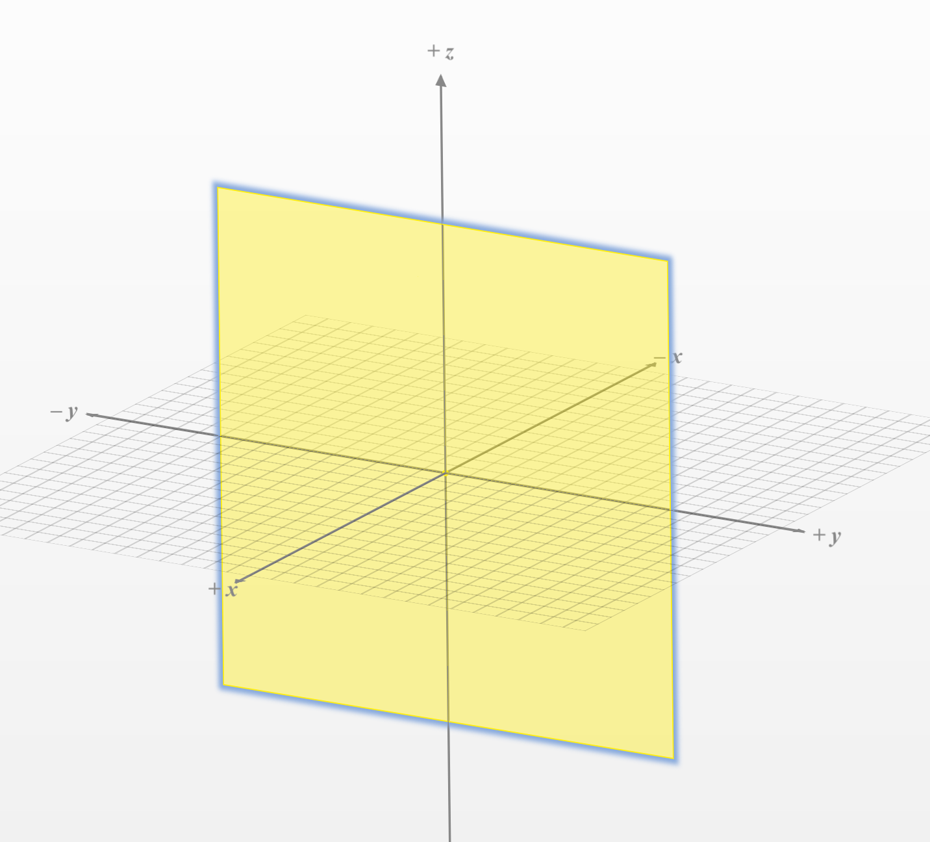
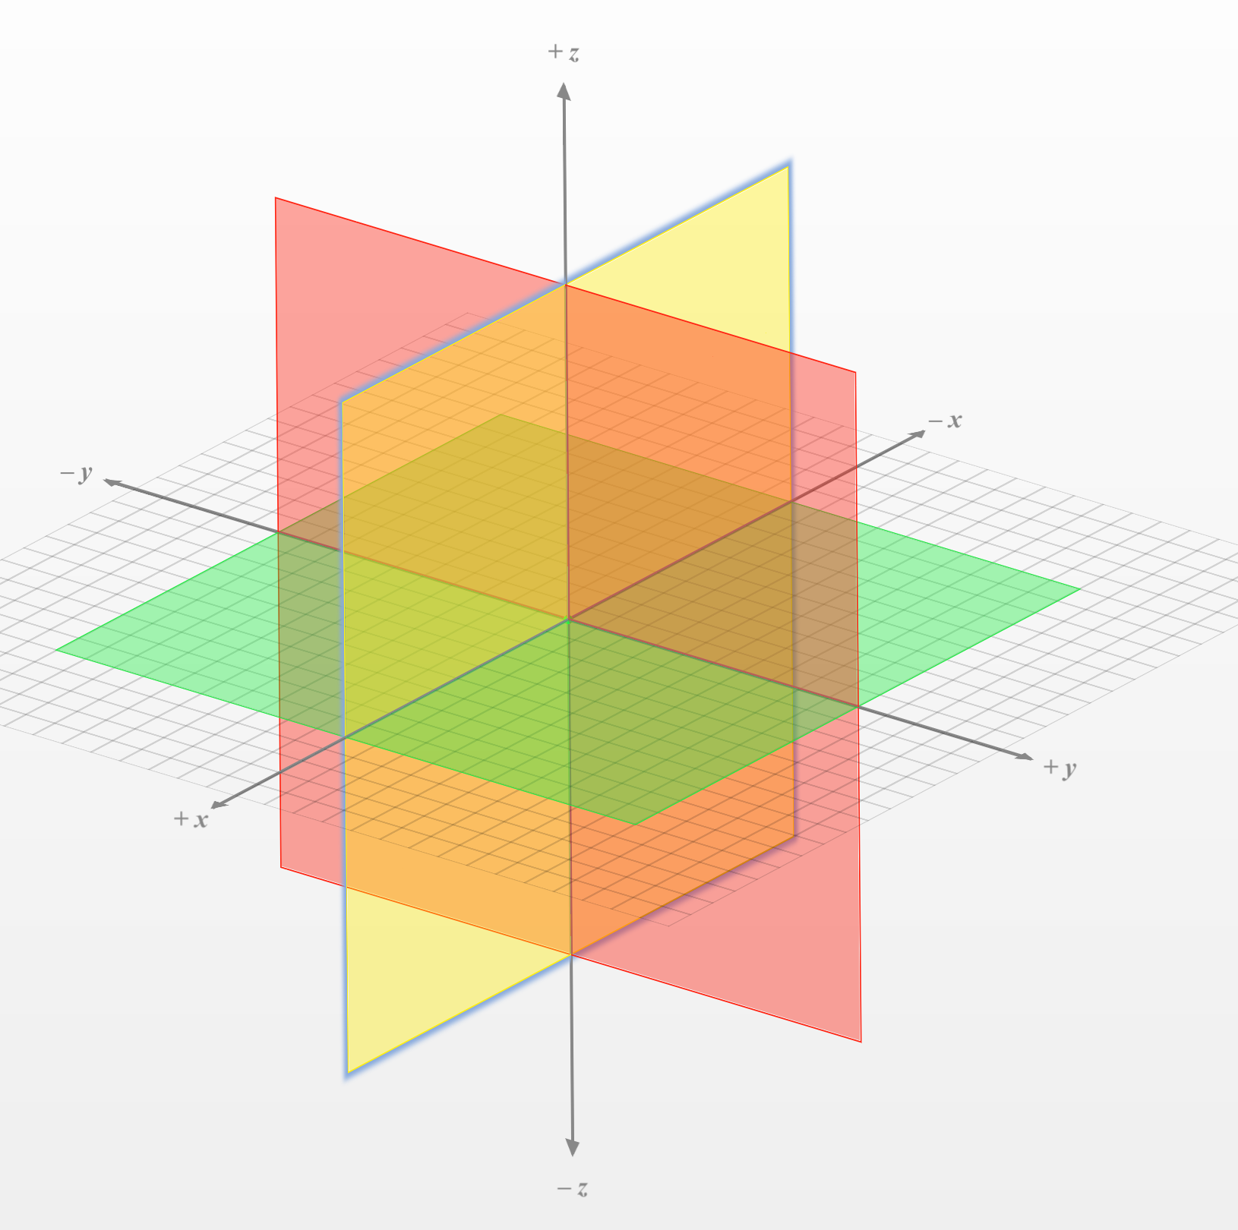
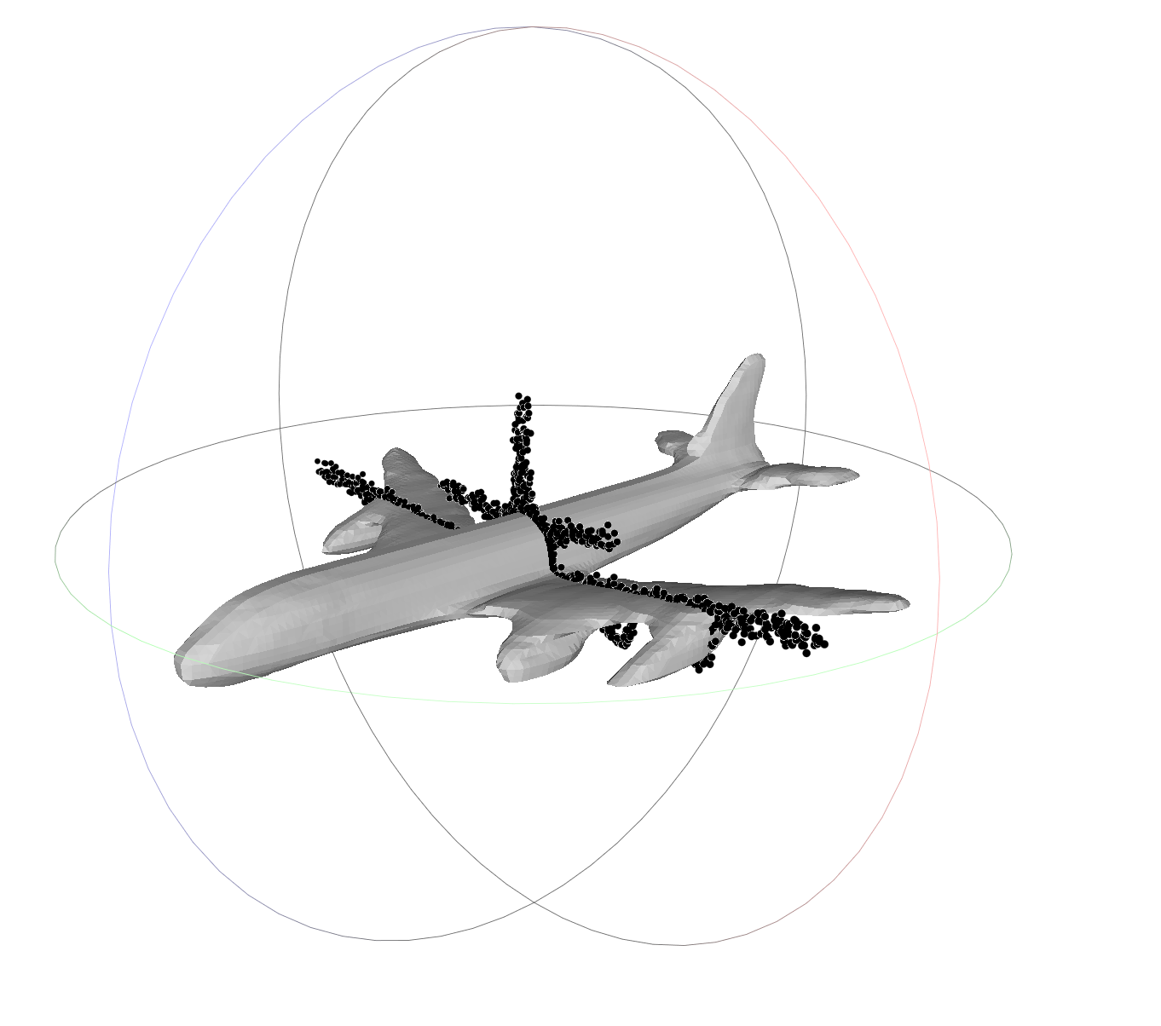
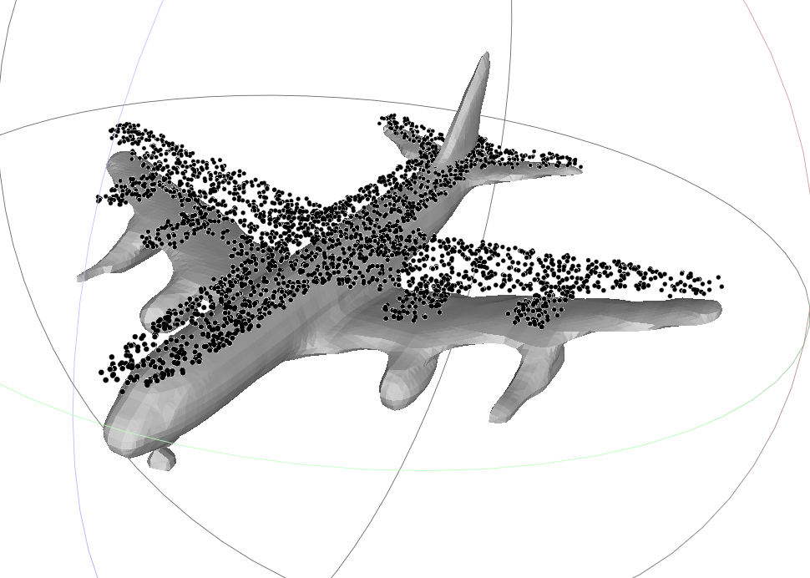
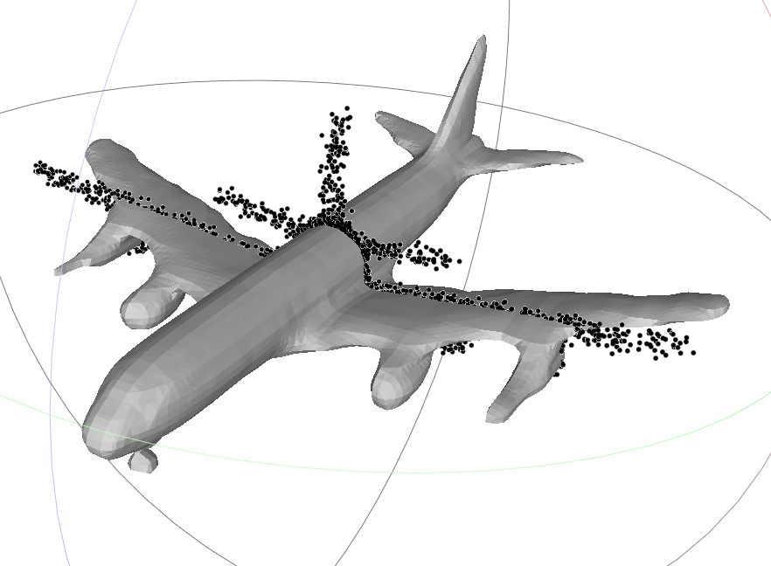
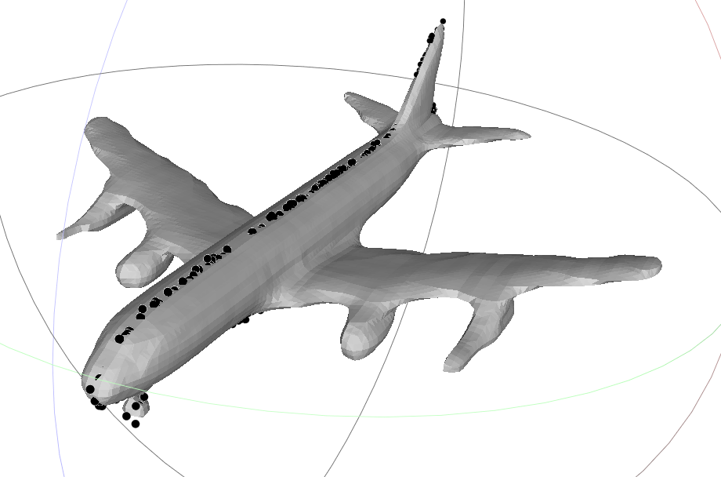
Distribution of learned planes
1 dynamic plane
3 dynamic planes
A canonical plane for all objects
Canonical planes for all objects
Stefan Lionar, Daniil Emtsev, Dusan Svilarkovic
5/27/2020
4

Slide 5
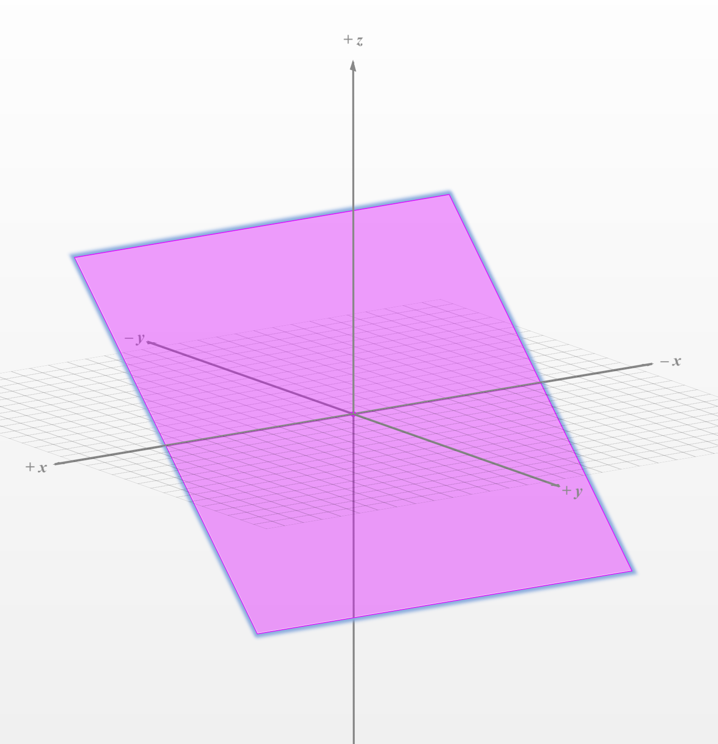
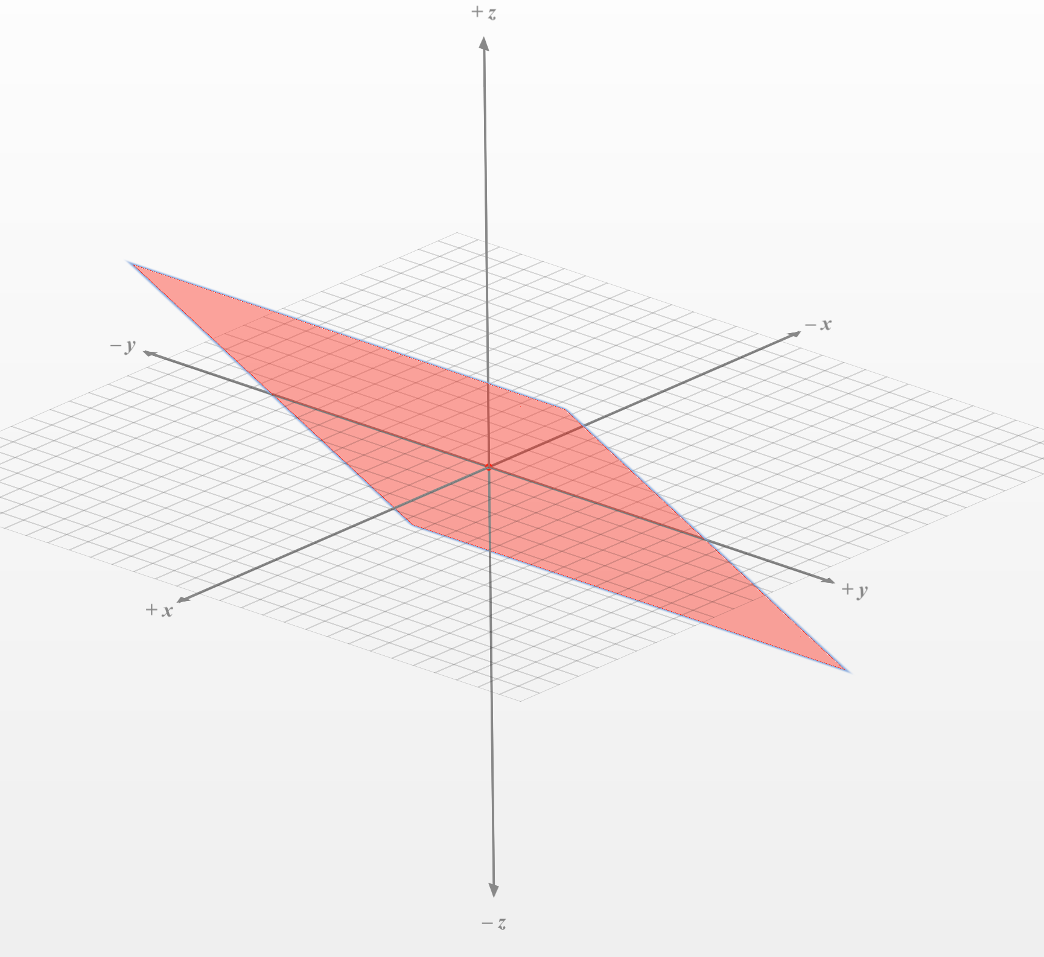
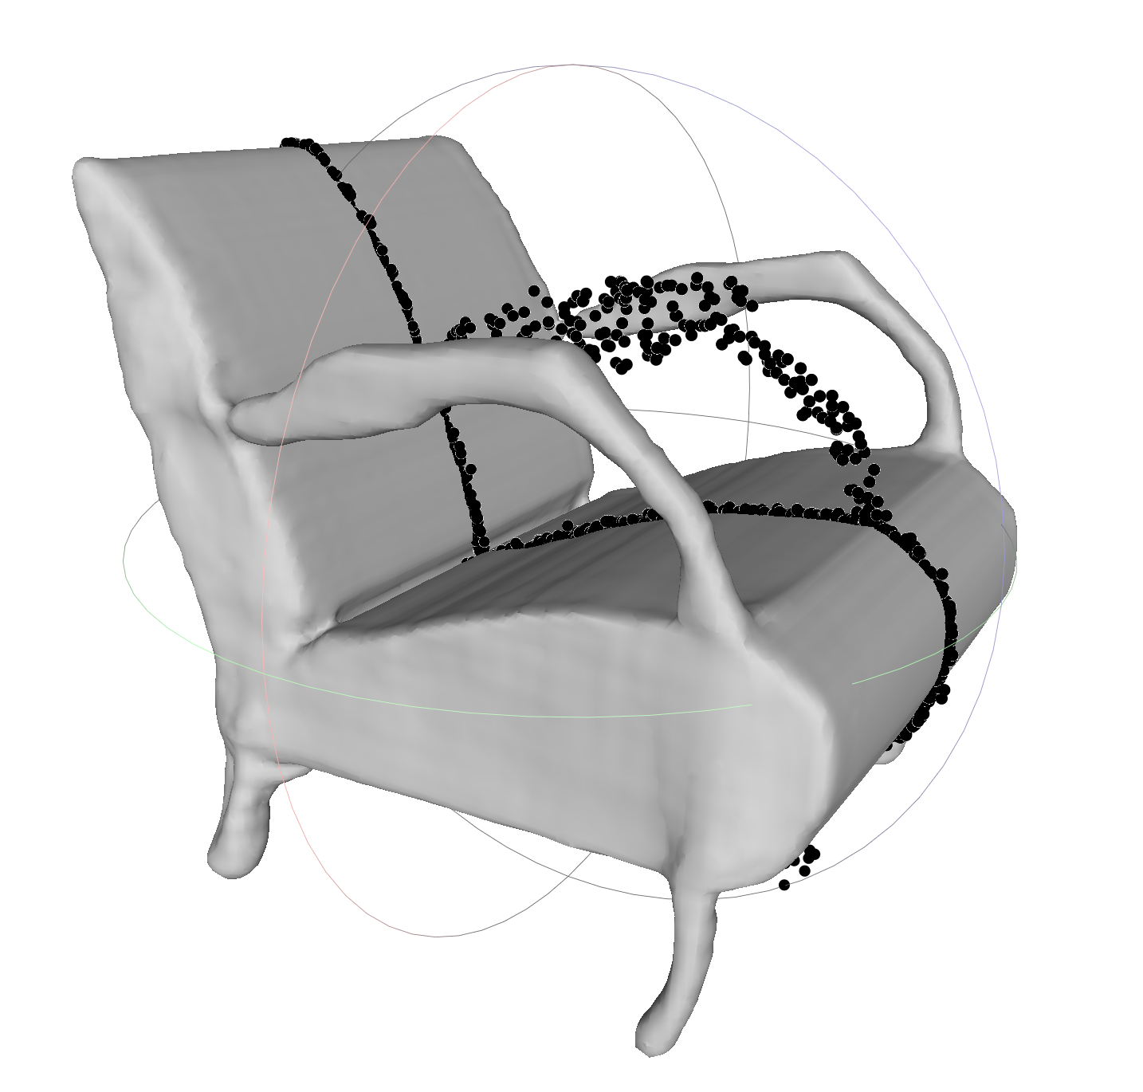
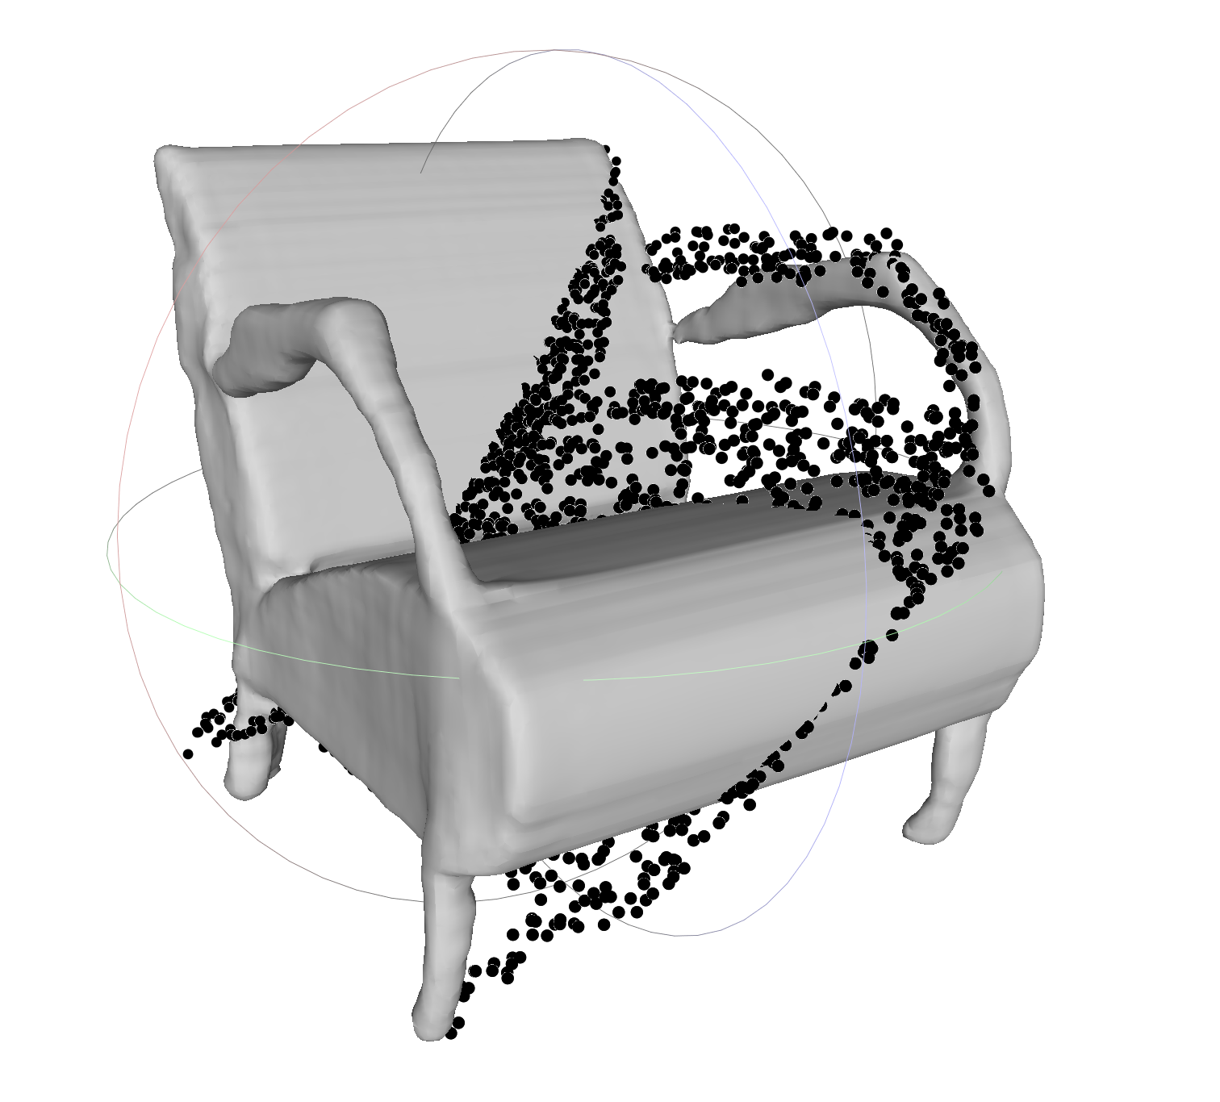
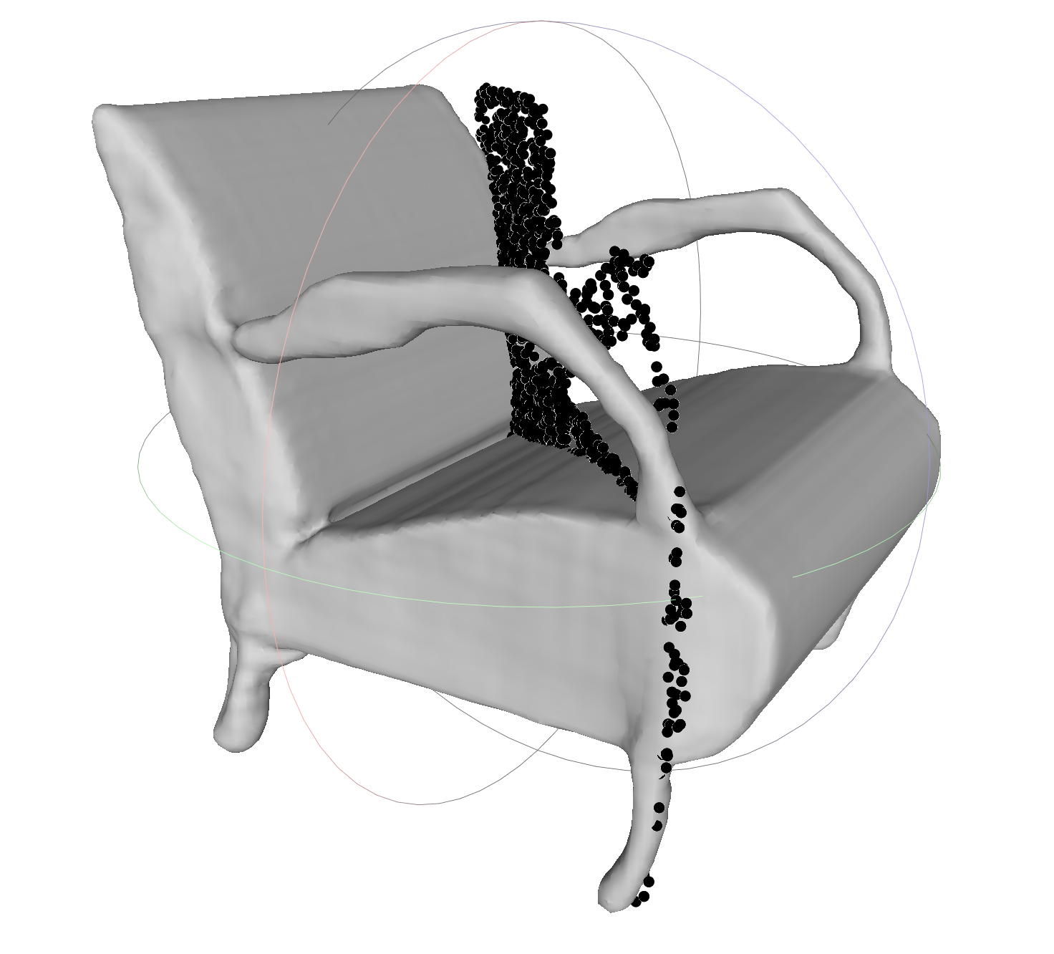
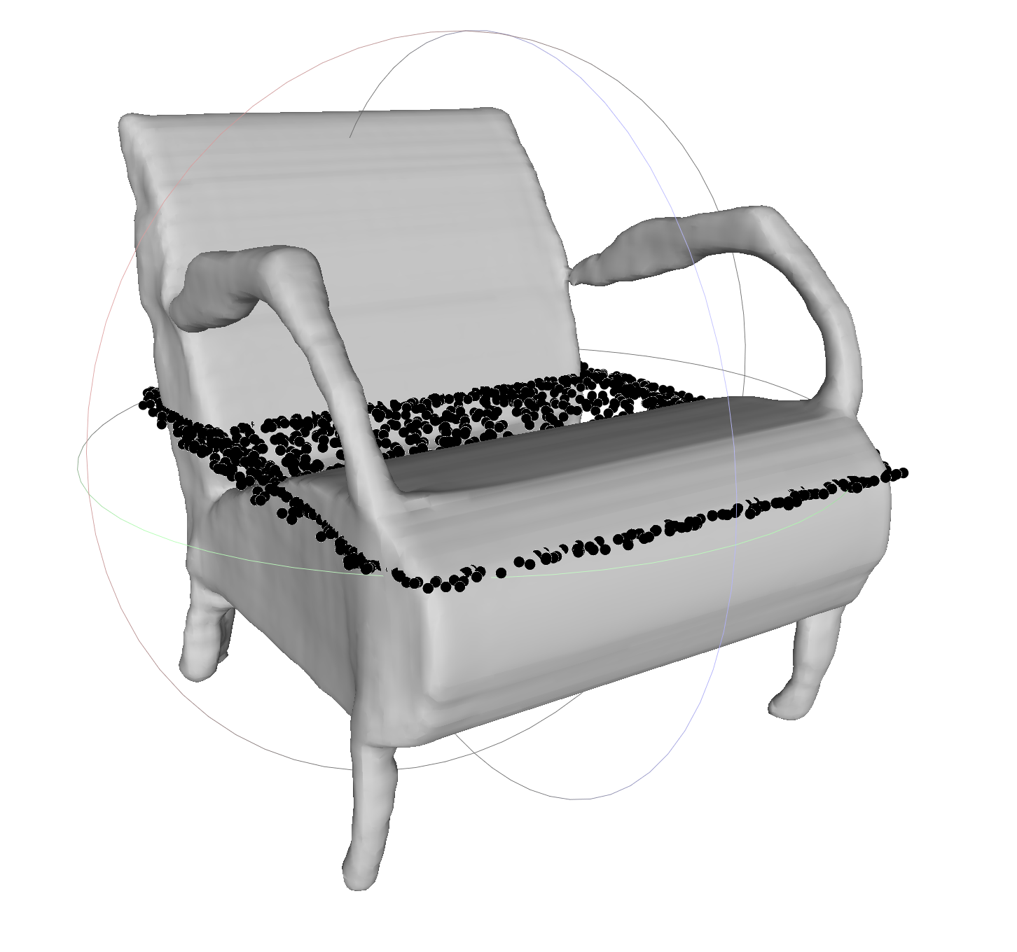
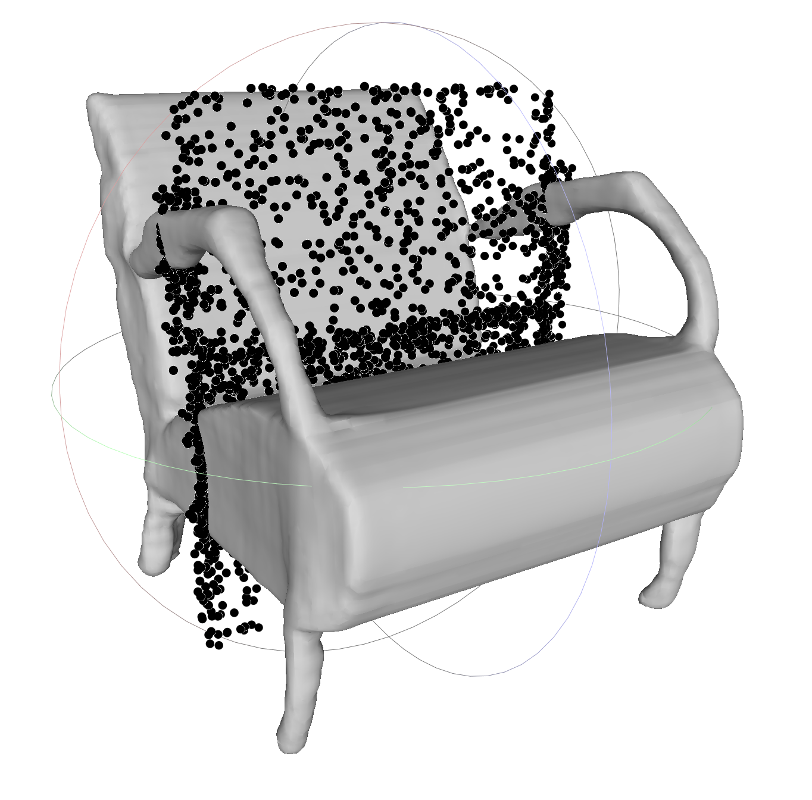
Distribution of learned planes – 5 dynamic planes
3 canonical planes for all objects
1 plane approximately: y + z = 0
Moderate spread among classes
1 plane approximately: -x + z = 0
Little spread among classes
Stefan Lionar, Daniil Emtsev, Dusan Svilarkovic
5/27/2020
5

Slide 6

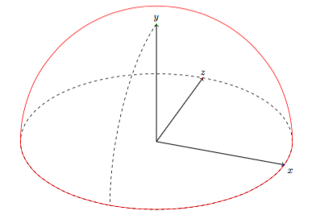
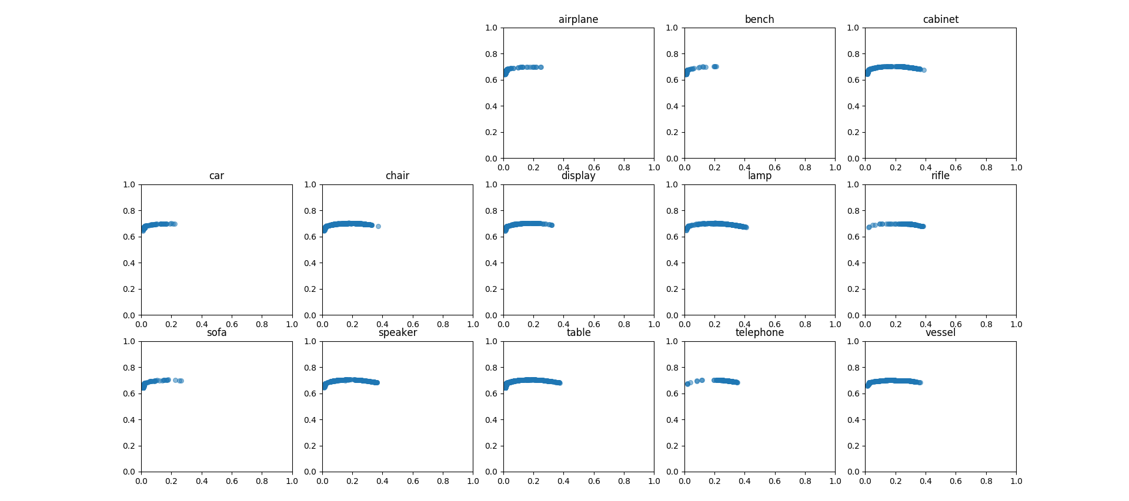
Plane distribution - 5 dynamic planes (moderate spread)
z
Normalized plane normal
y
x
Stefan Lionar, Daniil Emtsev, Dusan Svilarkovic
5/27/2020
6

Slide 7
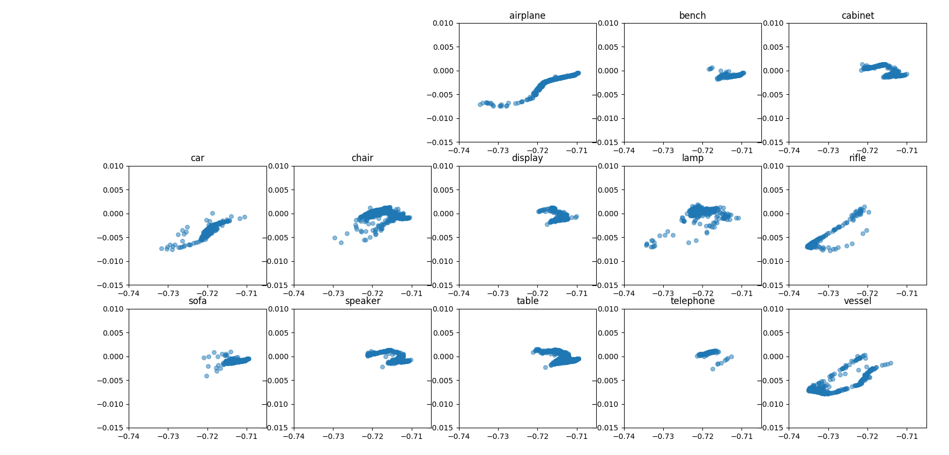
Plane distribution - 5 dynamic planes (little spread)
z
Normalized plane normal
y
x
Note the axes scale!
Stefan Lionar, Daniil Emtsev, Dusan Svilarkovic
5/27/2020
7

Slide 8
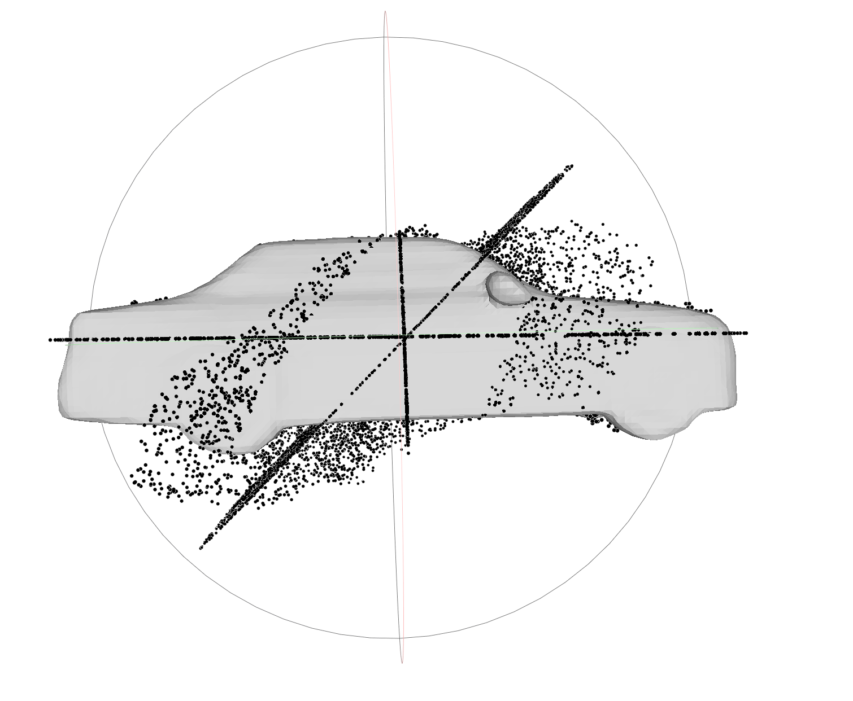
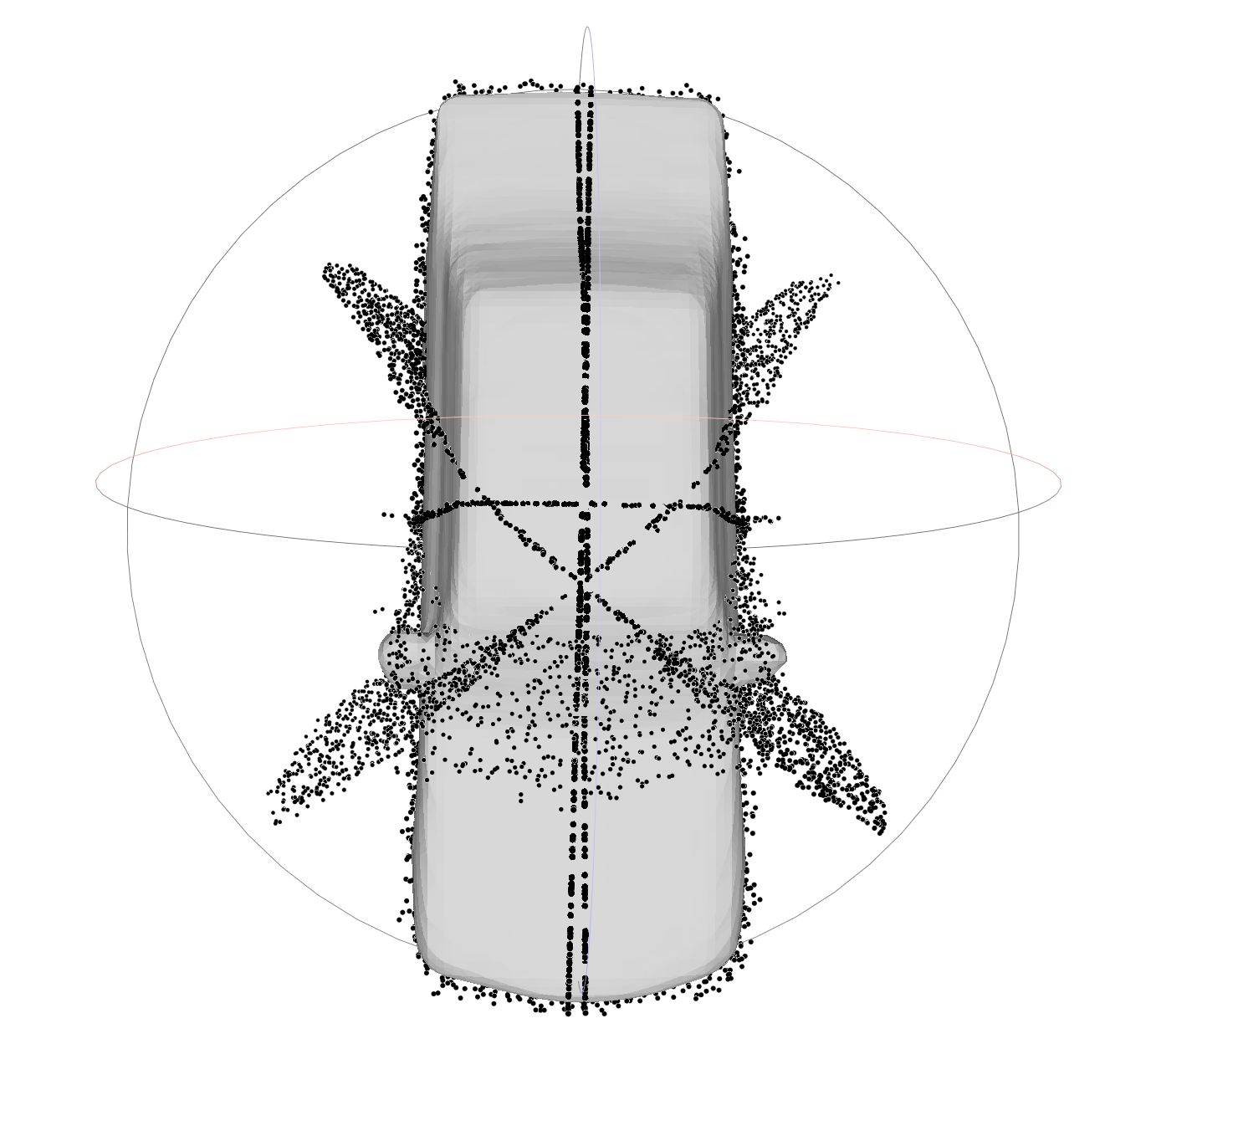
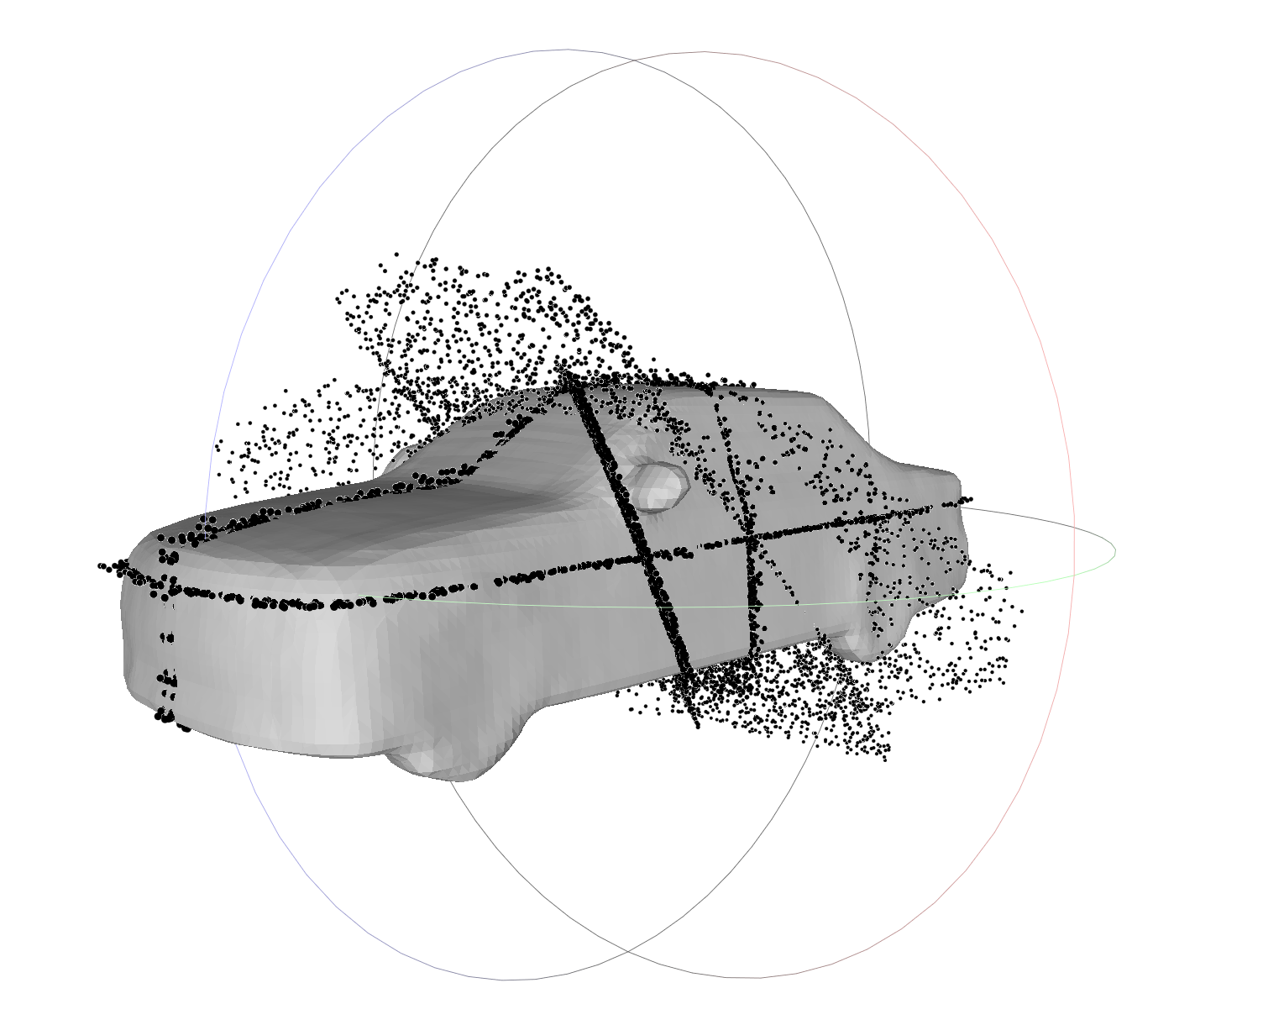
Distribution of learned planes – 7 dynamic planes
3 canonical planes + 1 redundant canonical plane for all objects
1 plane approximately:
x + 0.5y + z = 0
Little spread among classes
1 plane approximately:
x - 0.5y - z = 0
Little spread among classes
1 plane approximately:
-x + y = 0
Nearly identical among classes
+
+
+
Illustration: Input point clouds projected into 7 learned planes
Stefan Lionar, Daniil Emtsev, Dusan Svilarkovic
5/27/2020
8

Slide 9
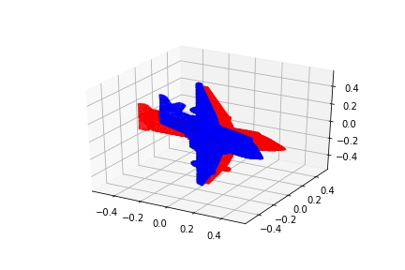
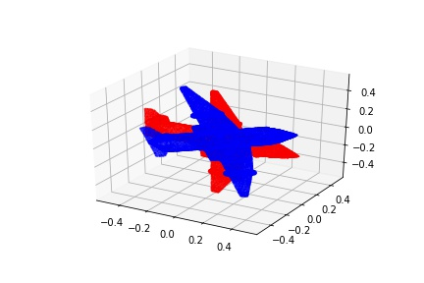
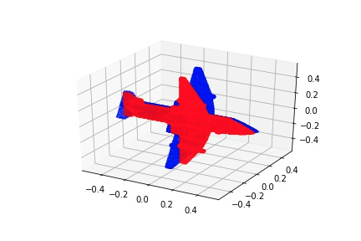
Testing rotational invariance
Pretrained Occupancy Network* vs 7 planes DPCO
Idea: Infer rotational invariance for DPCO
Rotate input objects: 15,30,45,60,75 and 90 degrees in all (x,y,z) axis
Validated and reconstructed on test set
*Mescheder, L., Oechsle, M., Niemeyer, M., Nowozin, S., & Geiger, A. (2019). Occupancy networks: Learning 3d reconstruction in function space. In Proceedings of the IEEE Conference on Computer Vision and Pattern Recognition (pp. 4460-4470).
Various rotations of default objects (blue pointcloud) to rotated object (red pointcloud)
Stefan Lionar, Daniil Emtsev, Dusan Svilarkovic
5/27/2020
9

Slide 10
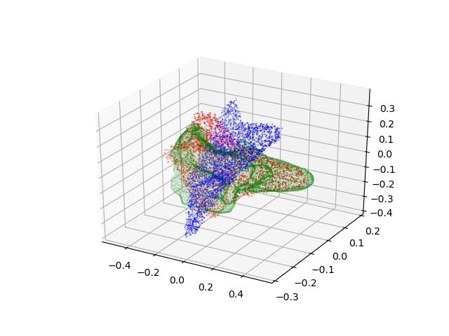
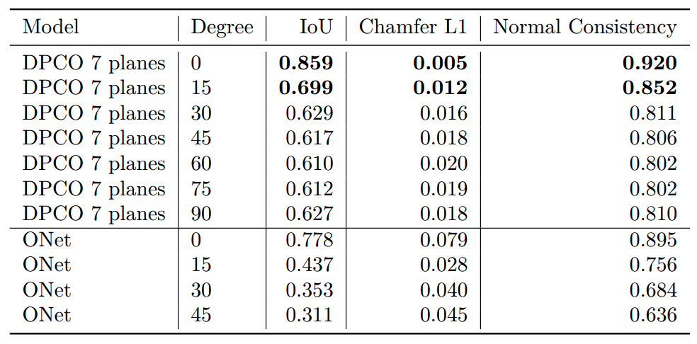
Testing rotational invariance - Results
Rotated reconstruction was not achieved.
Reconstruction in default position
Accuracy drop
Reason: ShapeNet dataset distribution, should include rotation augmentation into training
DPCO more consistent than ONet
All metrics on default positioned object vs reconstructed rotated object.
Red pointcloud - default positioned input model
Blue pointcloud - rotated input model
Green pointcloud – reconstructed rotated input model
Results for various degree ranges and different models.
Stefan Lionar, Daniil Emtsev, Dusan Svilarkovic
5/27/2020
10

Slide 11
Testing rotational invariance – Further work
Introduce rotation augmentation in training
Rotate planes along with the rotated input objects in testing
Rotate planes along with the rotated input objects in training
Single class training and compare differences between classes and their class accuracy distributions.
Results for various degree ranges and different models.
Red pointcloud - default positioned input model
Blue pointcloud - rotated input model
Green pointcloud – reconstructed rotated input model
Stefan Lionar, Daniil Emtsev, Dusan Svilarkovic
5/27/2020
11

Slide 12


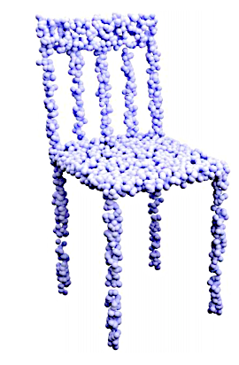
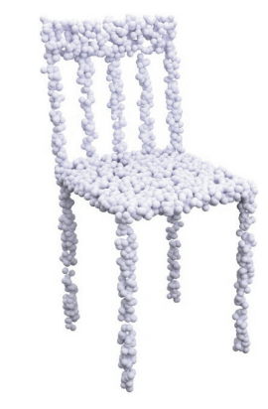
Idea: Projection into sphere
Sphere Projection
Sphere Disctretisation
Equirectangular mesh
Stefan Lionar, Daniil Emtsev, Dusan Svilarkovic
5/27/2020
12

Slide 13
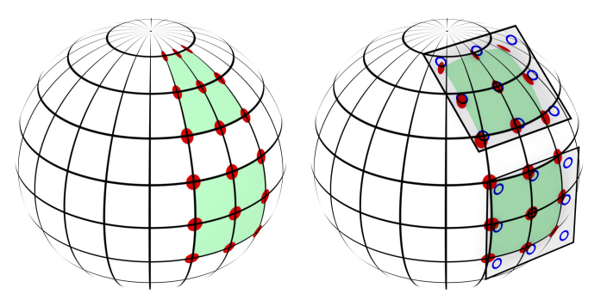
Cloud of input points
N x 3
Projections to planes
Projection to sphere
Sampling
3d point location
Occupancy
probability
Features N x d
Unet
Features
Pointnet
H
W
Plane Predictor
Bilinear Interpolation
Sphere Kernel
“SphereNet: Learning Spherical Representations for Detection and Classification in Omnidirectional Images”
Benjamin Coors, Alexandru Paul Condurache, and Andreas Geiger
Stefan Lionar, Daniil Emtsev, Dusan Svilarkovic
5/27/2020
13

Slide 14
Thank you! Any questions?
Stefan Lionar, Daniil Emtsev, Dusan Svilarkovic
5/27/2020
14

